Slide 1
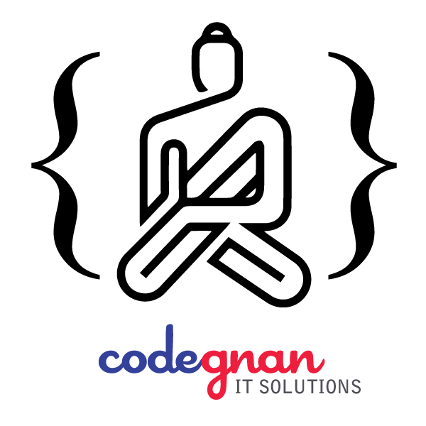
Python
10 Days Bootcamp
July 27 – August 06 5:00PM – 7:00PM

Slide 2
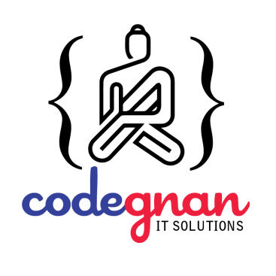
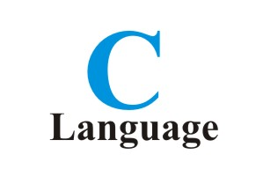
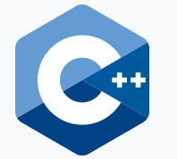
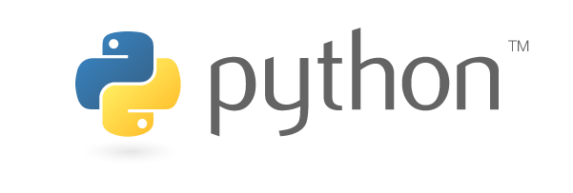
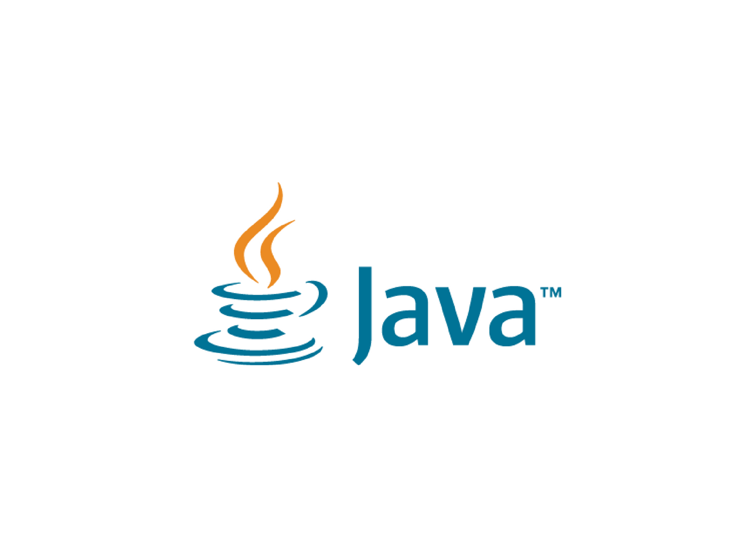
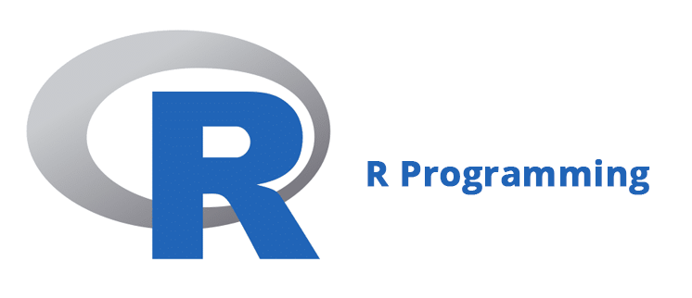

Slide 3


C Lang:
#include <stdio.h>
int main(void)
{
printf("hello, world\n");
}
Java:
class HelloWorld {
public static void main(String[] args) {
System.out.println("Hello, World!");
}
}

Slide 4

C Lang:
#include <stdio.h>
int main()
{
int num1, num2, sum;
printf("Enter first number: ");
scanf("%d", &num1);
printf("Enter second number: ");
scanf("%d", &num2);
sum = num1 + num2;
printf("Sum of the entered numbers: %d", sum);
return 0;
}

Slide 5
Java Program
public class AddTwoIntegers {
public static void main(String[] args) {
int first = 10;
int second = 20;
int sum = first + second;
System.out.println("The sum is: " + sum);
}
}

Slide 6

?
W
H
Y

Slide 7
Adding two numbers:
a = 5
b = 6
c = a + b
print(c)
Hello world:
print(“Hello World”)

Slide 8

Difference between programming and scripting

Slide 9
Basically, all scripting languages are programming languages.
The theoretical difference between the two is that scripting languages do not require the compilation step and are rather interpreted.
For example, normally, a C program needs to be compiled before running whereas normally, a scripting language like JavaScript or PHP need not be compiled.

Slide 10

Applications of Scripting Languages :
To automate certain tasks in a program
Extracting information from a data set
3. Less code intensive as compared to traditional programming
languages

Slide 11

Applications of Programming Languages :
They typically run inside a parent program like scripts.
More compatible while integrating code with mathematical models.
Languages like JAVA can be compiled and then used on any platform.

Slide 12

Some scripting languages traditionally used without an explicit compilation step are JavaScript, PHP, Python, VBScript.
Some programming languages traditionally used with an explicit compilation step are C, C++.

Slide 13
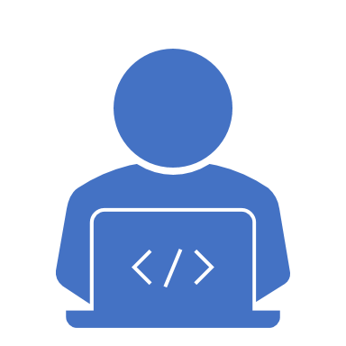
Python was invented by Guido
Van Rossum in 1991.
Python is easy to learn, popular programming language.
Python is Free and Open source.
Expressive Language. Python language is more expressive means that it is more understandable and readable.
Python is used for Web development , Software development, and Mathematics.

Slide 14

Applications in Python
Web and Internet Development
Applications of Python Programming in Desktop GUI
Science and Numeric Applications
Software Development Application
Python Applications in Education
Python Applications in Business (ERP)

Slide 15
Applications in Python
Database Access
Network Programming
Games and 3D Graphics
Console-based Applications
Computer Vision
Machine Learning
Robotics
Data Analysis

Slide 16
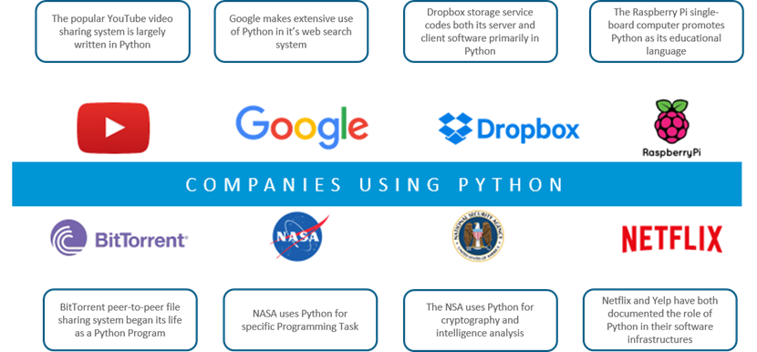

Slide 17
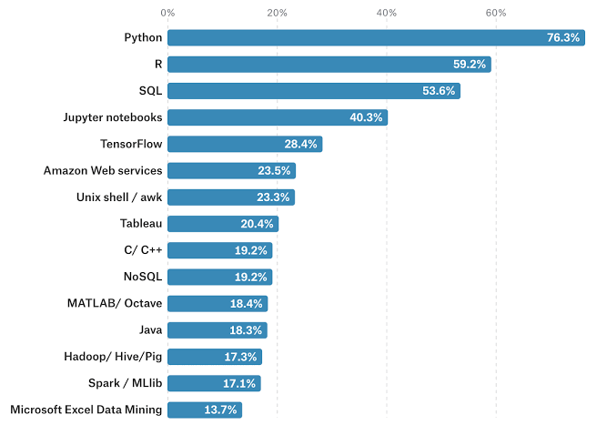

Slide 18
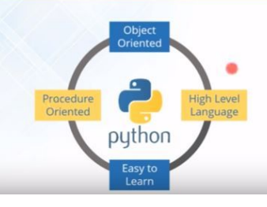
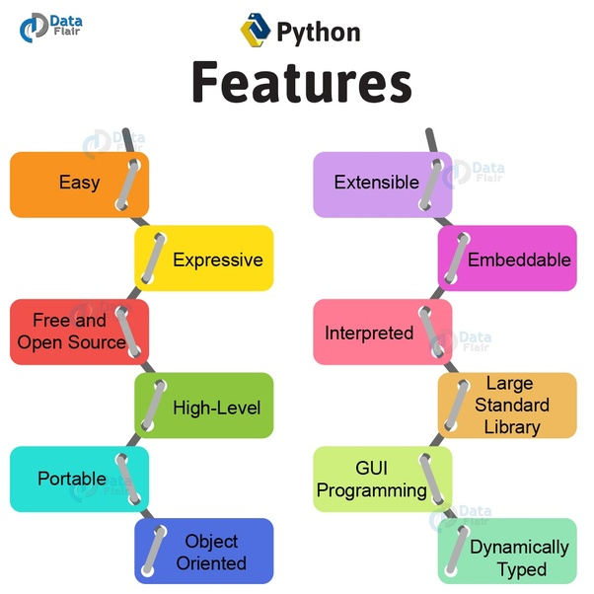

Slide 19
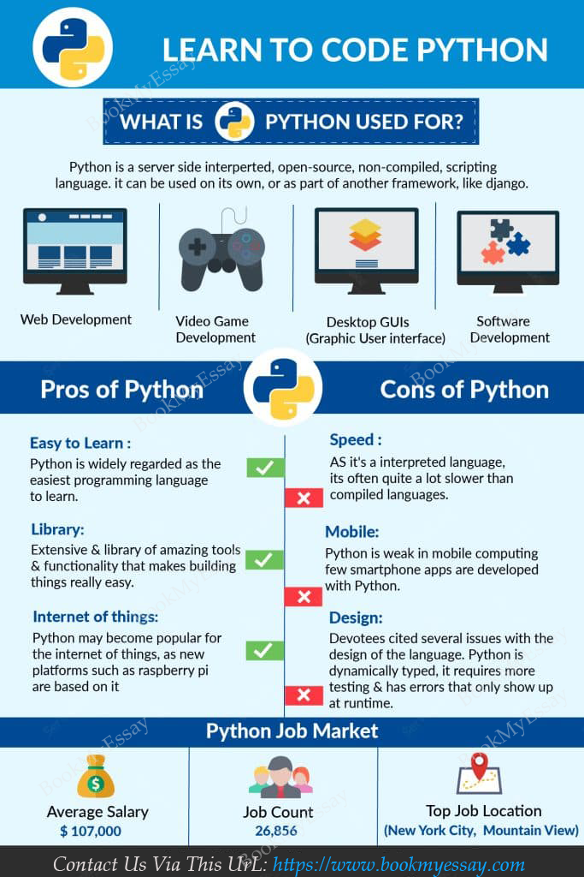

Slide 20
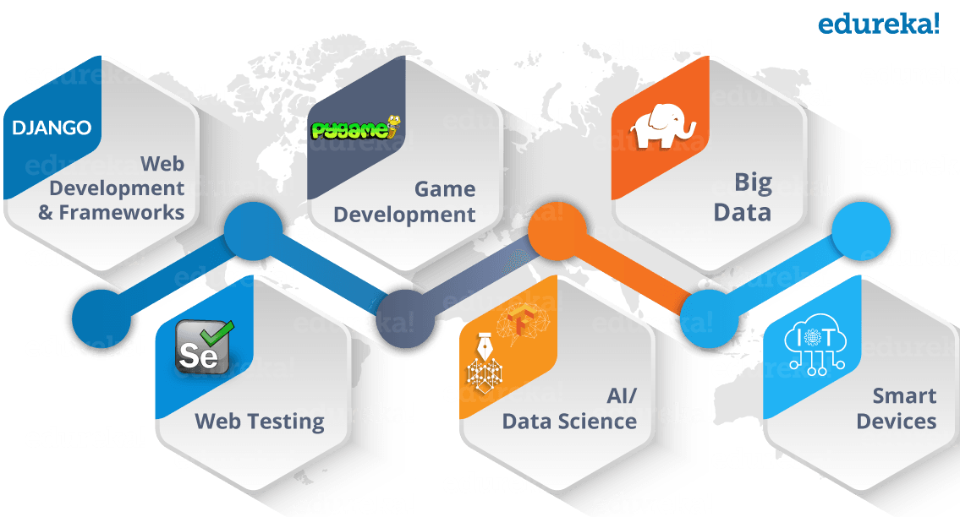

Slide 21

Python Installation and Setting Up Environment
Go to the www.python.org and click on the Downloads
Select the OS according to your Pc.
While installing we need to add the Path which is in the check box.

Slide 22
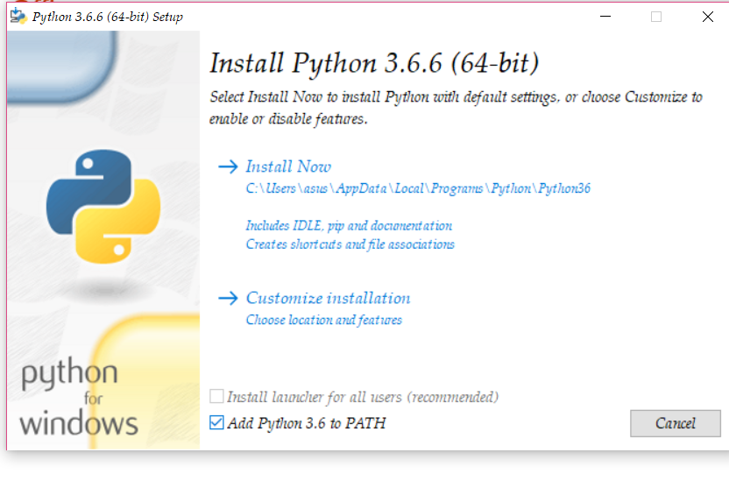
Go to the System Properties and click on Environment Variables

Slide 23
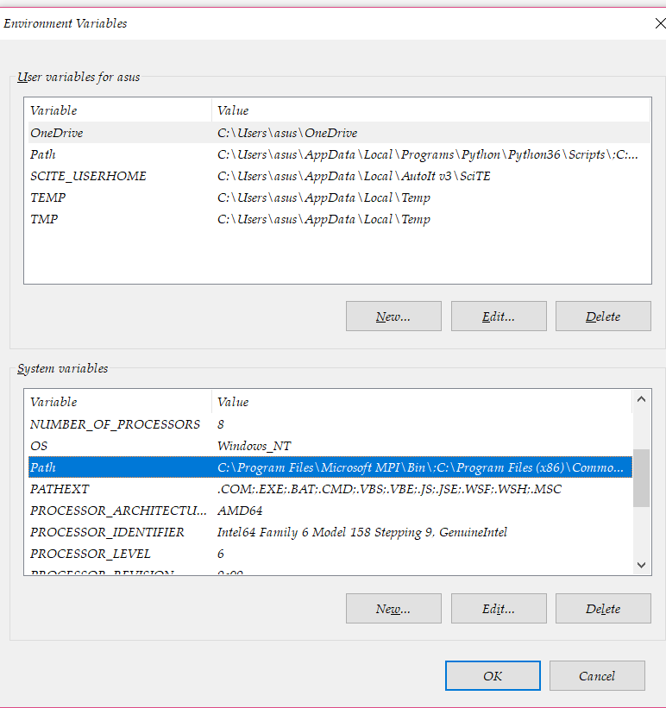
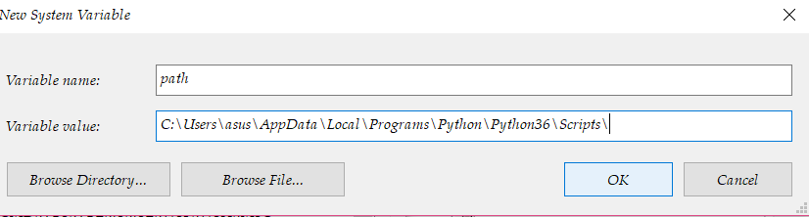

Slide 24
Variables
Variable is nothing but, the value that we assign for a letter or word.
variables are a storage placeholder for texts and numbers.
Python is dynamically typed, which means that you don't have to
declare what type each variable is.
Rules for variables:
A variable name must start with a letter or the underscore character.
A variable name cannot start with a number.
A variable name can only contain alpha-numeric characters and underscores (A-z, 0-9, and _ ).
Variable names are case-sensitive (age, Age and AGE are three different variables).
Example: x = “python”
y = “programming”
print(x+y) //output = “python programming”

Slide 25

Data types

Slide 26
Python has Six data types:
Number
String
List
Tuple
Dictionary
Sets

Slide 27
Number: Number data types store the numeric value. Number objects are created when you assign a value to them

Slide 28
There are four different numerical types:
Int
Float
Long
Complex

Slide 29
Data Type Conversions
Int
Float
String

Slide 30
Int: Int converts a float number or string to integer
Example: x = int(5) y = int(2.8) z = int(“3”) print(x) print(y) print(z)

Slide 31
Float : Float converts, float number from integer number or string literal.
Example:
x = float(1)
y = float(2.8)
z = float("3")
w = float("4.2")
print(x)
print(y)
print(z)
print(w)

Slide 32
String: Constructs a string from a wide variety of data types, including strings, integer literals and float literals.
Example:
x = str("s1")
y = str(2)
z = str(3.0)
print(x)
print(y)
print(z)

